Slide 1

Forecasting Housing Outcomes with $250K
A data-driven investment framework for navigating America's complex housing market
Mohammed Al-Muqsit, Kimiwa Sadat, Ibrahim Rahat, Anour Ibrahim, Avirup Ray, and Shafin Rehman

Slide 2
Table of Contents
01
02
03
Introduction & Problem
Method & Process
Dataset & APIs
Our analytical framework
Data sources and structure
Context and stakeholder needs
04
05
06
Modeling Approach
Business Intelligence
Technology Stack
Forecasting and financial analysis
Interactive Tableau dashboards
Tools and team roles
07
08
Expected Value
Q&A
Key insights and deliverables
Feedback and Questions

Slide 3
Introduction & Problem Statement
Context & Core Question
Goal
The U.S. housing market faces rising prices, high interest rates, and shifting migration patterns—making affordability a key challenge.
Build a live forecasting tool to compare long-term wealth outcomes for renting vs buying across 10 U.S. cities, delivering clear, data-driven insights for decision-makers.
With $250K to invest, the central question is: Is it smarter to buy a home or rent and invest elsewhere across major U.S. cities?
Stakeholders: First-time buyers, renters, investors, and financial advisors.

Slide 4








Method & Process
Our seven-stage analytical pipeline transforms raw market data into actionable investment intelligence
Problem Definition
Identify core investment question and success metrics
Data Collection
Pull real-time data via Zillow and FRED market APIs
Preprocessing
Clean and normalize datasets using Python and Pandas
Time-Series Forecasting
Apply ARIMA and Prophet models for price predictions
Financial Modeling
Calculate NPV, IRR, and break-even timelines
Visualization
Build live-connected Tableau dashboards
Insight Generation
Deliver actionable recommendations to stakeholders

Slide 5

Dataset & API Integration
We leverage industry-leading data sources to ensure forecast accuracy and real-time market responsiveness
Zillow API
FRED Economic API
Data Type: Median home values, rental estimates, inventory metrics
Data Type: 30-year mortgage rates, CPI inflation indices, unemployment rates
Coverage: City-level granularity across 10 major U.S. markets
Coverage: Historical and current macroeconomic indicators
Use Case: Foundation for price and rent trend forecasting
Use Case: Discount rate adjustments and inflation scenario modeling

Slide 6
Dataset & API Integration
Current Challenges
Needed permission from Bridge Interactive to use official Zillow API
Rate limitation: Need to be careful or else can be blocked or spend free tier
Workarounds: Using Screapeak API to scrape Zillow listing in each city

Slide 7
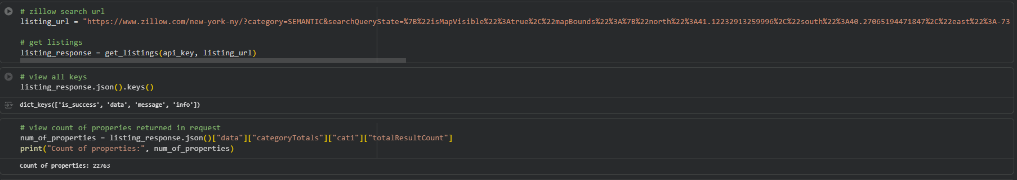
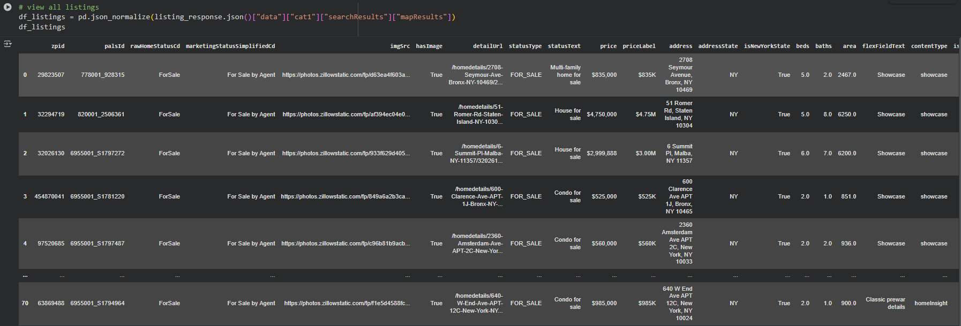

Slide 8
Modeling & Analytical Framework
Core Models
Key Output Metrics
Time-Series Forecasting
Critical Outputs:
ARIMA and Prophet models project future rent and home price trends
Break-even year calculation (rent vs buy)
Net wealth projection at key future intervals
Sensitivity analysis for mortgage rate and inflation changes
Financial Analysis
NPV and IRR calculations to evaluate long-term wealth outcomes
Scenario Simulation
Compare multiple strategies (e.g., cash purchase, 30-year mortgage, REIT investment)

Slide 9




Interactive Business Intelligence
Our Tableau dashboards transform complex data into intuitive, actionable visualizations for stakeholders
City Comparison Map
Break-Even Timeline
Geographic heat map displaying forecasted monthly costs — mortgage vs. rent — across all 10 target cities with color-coded affordability ratings
Dynamic line chart revealing exactly when buying becomes more cost-effective than renting for each market scenario
Wealth Projection Chart
Parameter Controls
30-year net wealth comparison visualizing cumulative returns for rent-and-invest, purchase, and REIT strategies
Interactive sliders enabling users to adjust mortgage rates, down payment percentages, inflation assumptions, and investment return expectations in real-time

Slide 10











Technology Stack
Data Extraction
Tools: Python 3.9+, Requests library
APIs: Zillow Research and FRED Economic Data
Function: Automated data retrieval and API connection management
Processing & Analysis
Tools: Pandas, NumPy, Jupyter Notebook
Function: Data cleaning, transformation, exploratory analysis, and quality validation
Modeling Engine
Tools: Statsmodels (ARIMA), Prophet, custom NumPy financial calculators
Function: Time-series forecasting, NPV/IRR computation, scenario simulations
Data Storage
Tools: PostgreSQL (optional for historical archiving)
Function: Persistent storage for model outputs and audit trails
Visualization Layer
Tools: Tableau Desktop with live API connections
Function: Interactive dashboards, parameter controls, stakeholder reporting

Slide 11
Team Structure & Responsibilities
API & Data Engineering (Mohammed Al-Muqsit)
Time-Series Modeling (Avirup Ray)
Responsible for API integrations, data pipeline architecture, and dataset refresh automation
Develops and validates ARIMA/Prophet forecasts, handles model tuning and accuracy evaluation
Financial Analysis (Shafin Rehman)
Tableau Dashboards (Ibrahim Rahat)
Builds NPV/IRR calculators, rent-vs-buy break-even logic, and long-term wealth projections
Designs interactive dashboards, parameter controls, and performance-optimized visualizations
Project Leadership & Communication (Kimiwa Sadat)
Data Quality & Research (Anour Ibrahim)
Validates data sources, documents assumptions, supports feasibility testing, handles supporting datasets
Coordinates deliverables, manages deadlines, leads pitch prep, handles stakeholder communication
Team responsibilities may shift as the project evolves; roles are collaborative and flexible.

Slide 12




Expected Insights & Value Delivery
Our analysis will answer the most critical questions facing today's housing market participants
Which cities offer the fastest break-even for homebuyers?
How do mortgage rate fluctuations impact long-term outcomes?
Identify markets where purchasing becomes more economical than renting in the shortest time frame, accounting for local price trends and rental rates
Quantify the sensitivity of buy-vs-rent decisions to interest rate changes, revealing optimal entry points for different rate environments
Is direct ownership always superior to REIT investments?
What purchasing power does $250K deliver in 2025?
Challenge conventional wisdom by comparing real estate investment trusts against direct property ownership for risk-adjusted returns
Provide concrete benchmarks for down payment strategies, mortgage qualification scenarios, and expected property access across target markets
Bottom Line: Empowering investors and homebuyers with data-driven clarity in an uncertain market

Slide 13
Q&A
Thank You!!!

